Slide 1
SQL Injection Protection
Through an implementation of a website simulation

Slide 2
Problem Statement
SQL is ubiquitously used database management system that is vulnerable to SQL injection attacks.
Our goal is to test ways to make code robust to SQL injections and test the ways in which a malicious source may attempt to thwart safety measures.

Slide 3
Motivation
SQL Injection poses a persistent threat, exploiting vulnerabilities in database systems to access sensitive data.
Organizations heavily relying on databases continue to face significant risks ranging from data leaks to system failures. This amplifies the need for a continued effort to improve and create robust cybersecurity measures.
Notes:
Ester

Slide 4
Motivation
This project aims to enhance cybersecurity in database environments through input validation and understanding of SQL injection vulnerabilities.
Notes:
Ester

Slide 5
Contributions
In our exploration of SQL injection protection, we are delving into a pivotal aspect of database security. SQL, as a widely employed database management system, is susceptible to SQL injection attacks, posing significant risks to data integrity and system security.
Our objective is to pioneer innovative strategies aimed at fortifying code against SQL injection vulnerabilities. By meticulously testing and refining these techniques, we aim to establish robust safeguards that withstand malicious attempts to compromise data integrity and system functionality.

Slide 6
Contributions …
Through rigorous experimentation and analysis, we are uncovering insights into the various tactics employed by malicious actors to circumvent security measures. By understanding these attack vectors, we can proactively develop countermeasures to bolster the resilience of database systems against potential threats.
Our contributions extend beyond mere theoretical advancements; we are committed to delivering practical solutions that empower organizations to mitigate the risks associated with SQL injection attacks effectively. By disseminating our findings and recommendations, we aim to foster a culture of enhanced database security and resilience within the broader technological landscape.

Slide 7
Methodology
Testing out SQL injections poses some legal implications, meaning we can’t just attack any site we feel like.
To get around this we developed our own website that we could use as an attack surface.
Notes:
Lasair

Slide 8
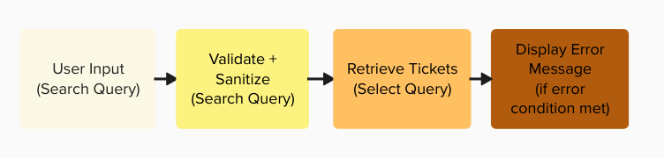
Methodology
Search Functionality: Search Bar
On the front-end, the search bar allows users to input their search query and submit via HTML form.
The back-end, managed by Flask, validates and sanitizes the query, executes a SELECT query to retrieve matching tickets from the database, and displays any relevant error messages if necessary.
Notes:
Ester

Slide 9
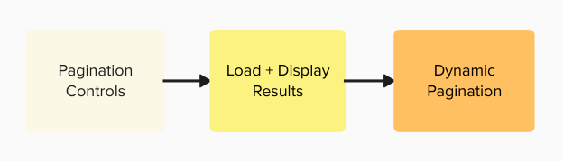
Methodology
Search Functionality: Search Results
Displayed on the front-end, the search results table features a user-friendly design with pagination controls.
Utilizing JavaScript, the table dynamically loads and displays results, creating a responsive and intuitive user experience.
Notes:
Ester

Slide 10
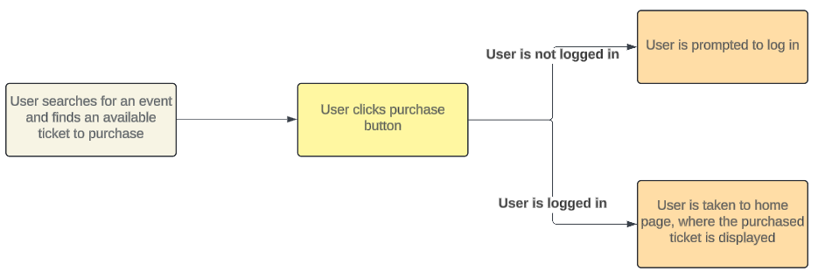
Methodology
Purchase Button Functionality: Front-End
Users interact with the website by navigating to the Find Tickets page, where they search for desired tickets. The Purchase button is prominently displayed on available tickets. If logged in, the user's purchase request is processed; if not logged in, they are redirected to the login page for authentication.
Notes:
Emely

Slide 11
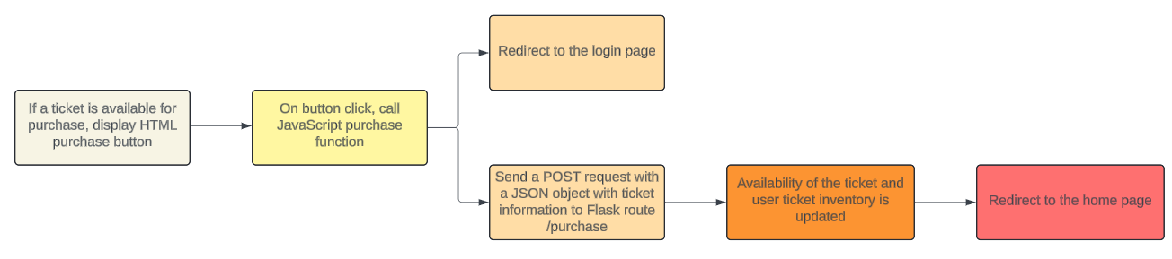
Methodology
Purchase Button Functionality: Back-End
Flask receives a POST request from the client-side, validating user authentication and ticket data. It then calls the update_availability function in query.py to update the database, marking the selected ticket as unavailable and adding it to the user's ticket inventory. This backend process ensures data integrity and transactional consistency, confirming the successful purchase and redirecting the user to the home page for a seamless browsing experience.
Notes:
Emely

Slide 12
Methodology
User Accounts
The user accounts are maintained by a database within MySQL. An entry is added when a user interacts with the create account page, submitting a needed information. When the user hits submit a POST request is sent to the flask application that then creates a query adding the information to the database. This information is then used when a user logs in to the site.
Notes:
Emely

Slide 13
Website Layout
To create a versatile attack surface we decided to mimic a ticket purchasing site.
Our site has three primary areas where an SQL injection attack can be implemented:
User login
User account creation
Ticket searches
Notes:
Lasair

Slide 14
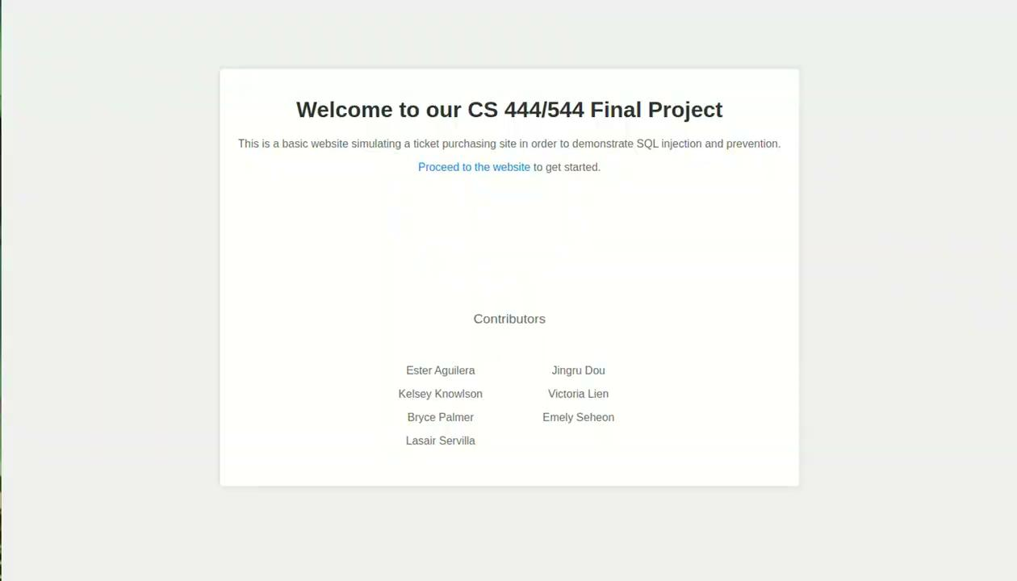
Walkthrough- User account creation
* videos were recorded prior to some code changes and latest version may contain some minimal visual changes
Notes:
Lasair

Slide 15
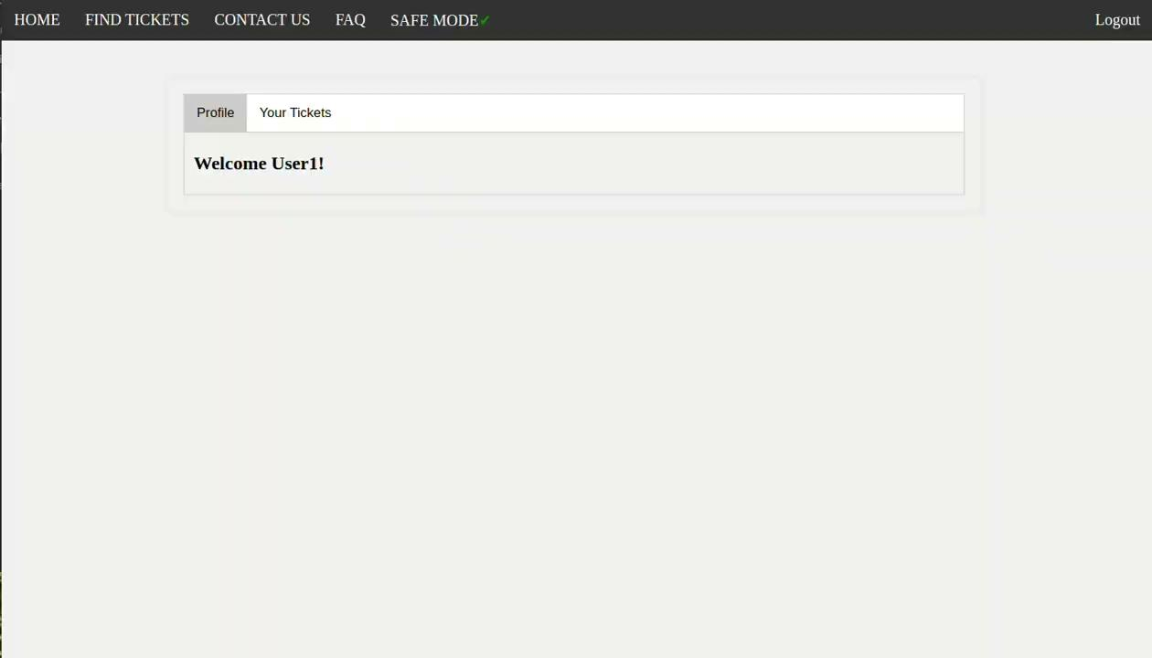
Walkthrough- Ticket purchasing
* videos were recorded prior to some code changes and latest version may contain some minimal visual changes
Notes:
Lasair

Slide 16
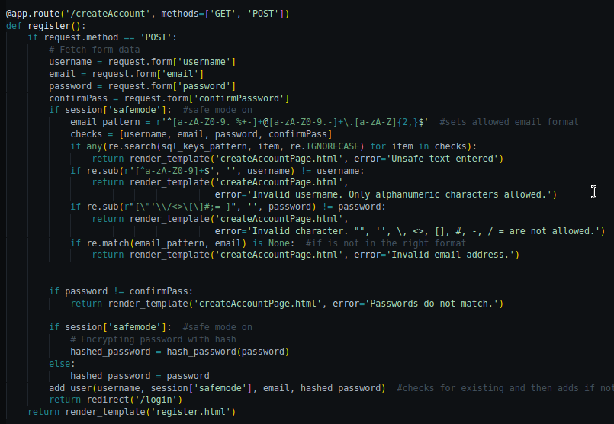
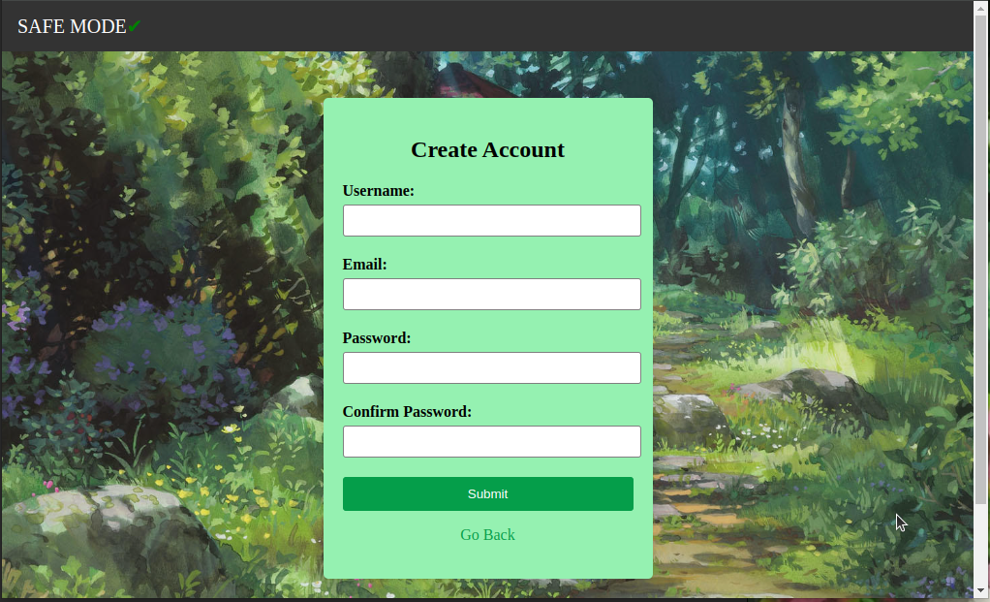
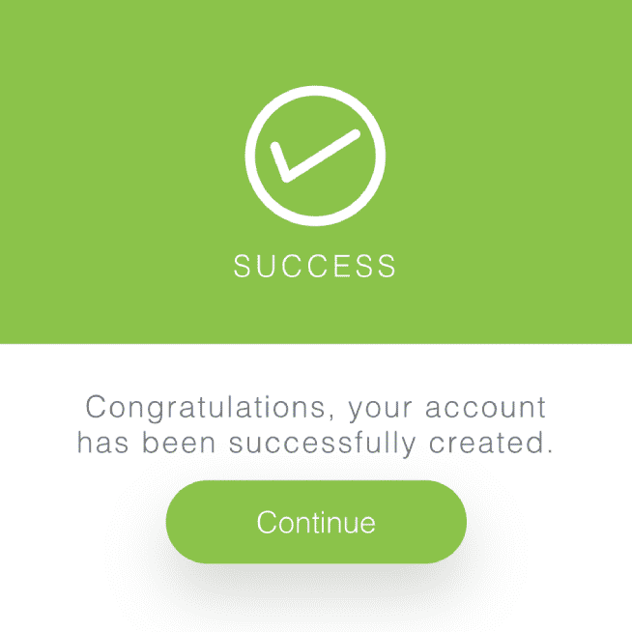

Behind The Scenes- User account creation
HTTP POST allows us to get the
user input after they hit submit.
The input is then used to make a SQL query looking to see if the user does not already exist.
If it is a new user all the information is saved to the database. The password gets hashed and all other information is entered as plain text.
Notes:
Lasair

Slide 17
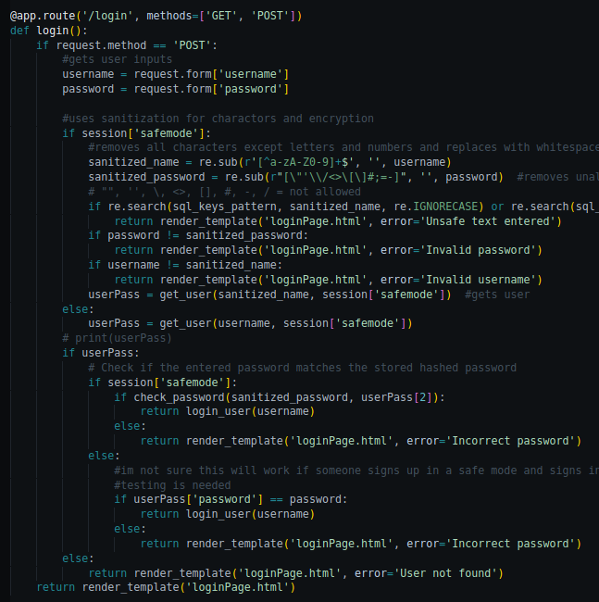
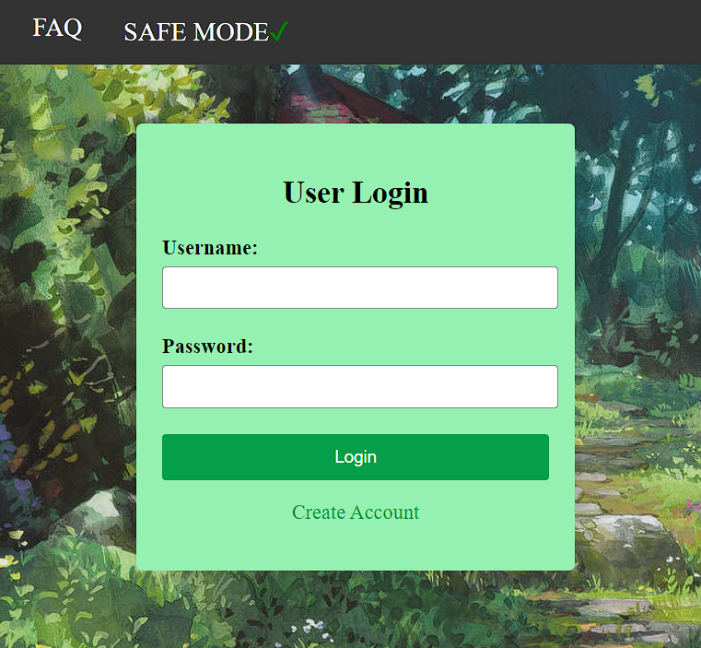
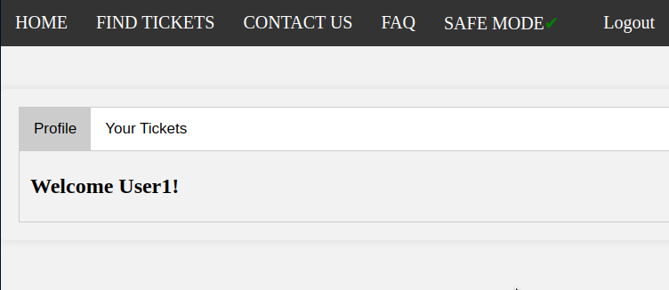
Behind The Scenes- User Login
HTTP POST allows us to get the
user input after they hit login.
If the user and password are verified, then the user is logged in. A user can see both their profile and a list of their purchased tickets.
The input is then used to make a SQL query to obtain the user and their corresponding password
Notes:
Lasair

Slide 18
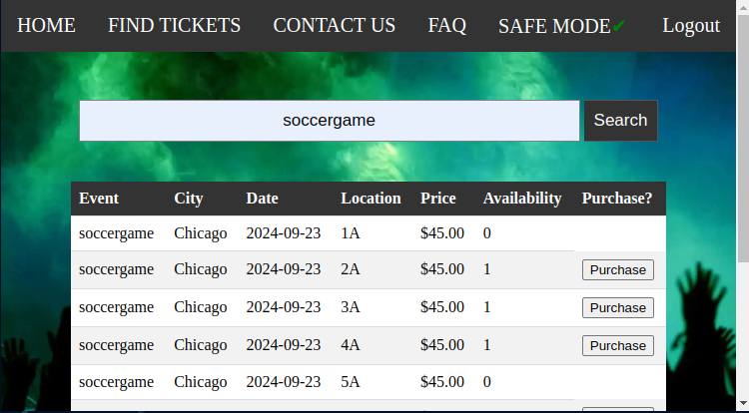
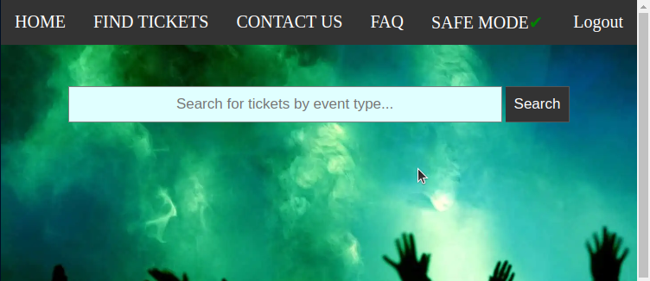
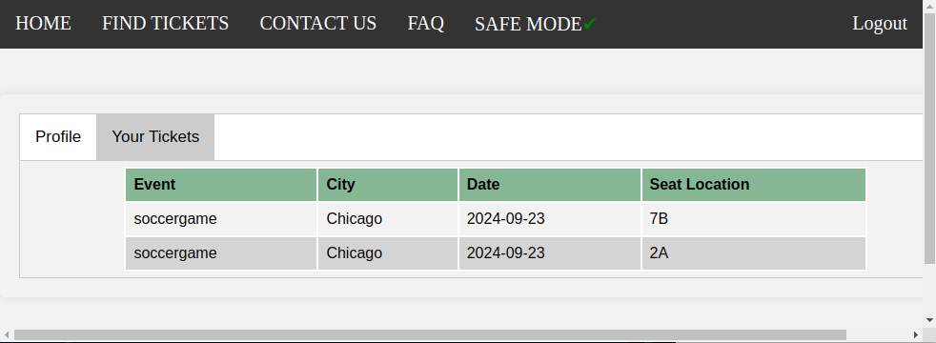
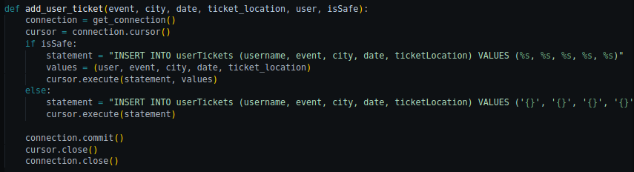
Behind The Scenes- User ticket tracking
HTTP POST allows us to get the the search term after the user hits the search button.
A SQL query is made with the term and all matching results are displayed.
A user can then hit the ‘Purchase’ button that triggers another HTTP method. From there two separate actions are taken…
A SQL query for all the tickets associated with the current user allows the users purchased tickets to be displayed.
…The ticket availability is updated within the ‘events’ database and the ticket information as well as purchasing user is added to the ‘userTickets’ database.
Notes:
Lasair

Slide 19
Safe Mode
A safe and non-safe mode were implemented to test effectiveness of safety metrics used to prevent SQL injection
Safe Mode Enabled
Safe Mode Disabled

Slide 20
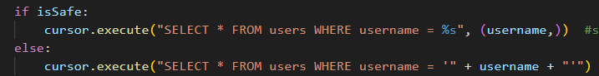
Safe Mode Features
Parameterized Inputs-
prevents direction insertion of input into SQL query
Input Validation -
verifies correct formatting of input
Sanitized Inputs-
removes potentially dangerous characters from input

Slide 21
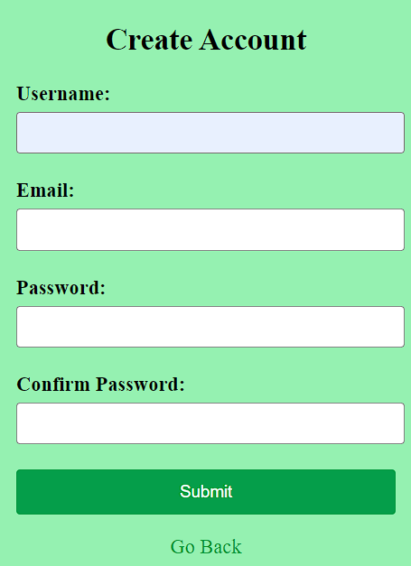
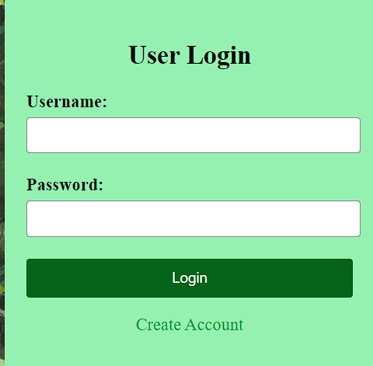
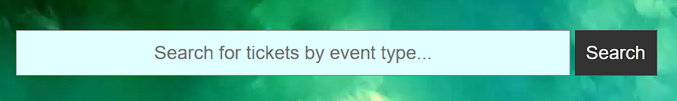
Safe Mode Applications
Safety measures are implemented at all user input boxes in the website user interface
Create Account Page
Login Page
Search Ticket Page

Slide 22
Findings and Results
MySQL prevents single quote character ‘ from being processed in certain string queries…
String concatenation
versus format() method
Result: Inability to attack several input fields on site’s unsafe mode, except when creating account.

Slide 23
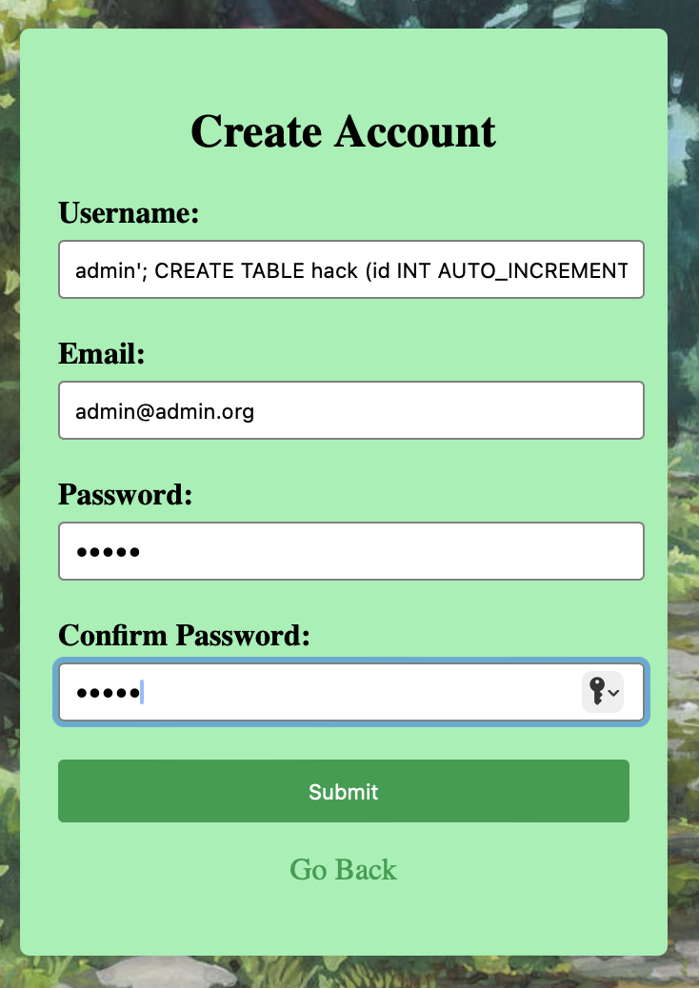
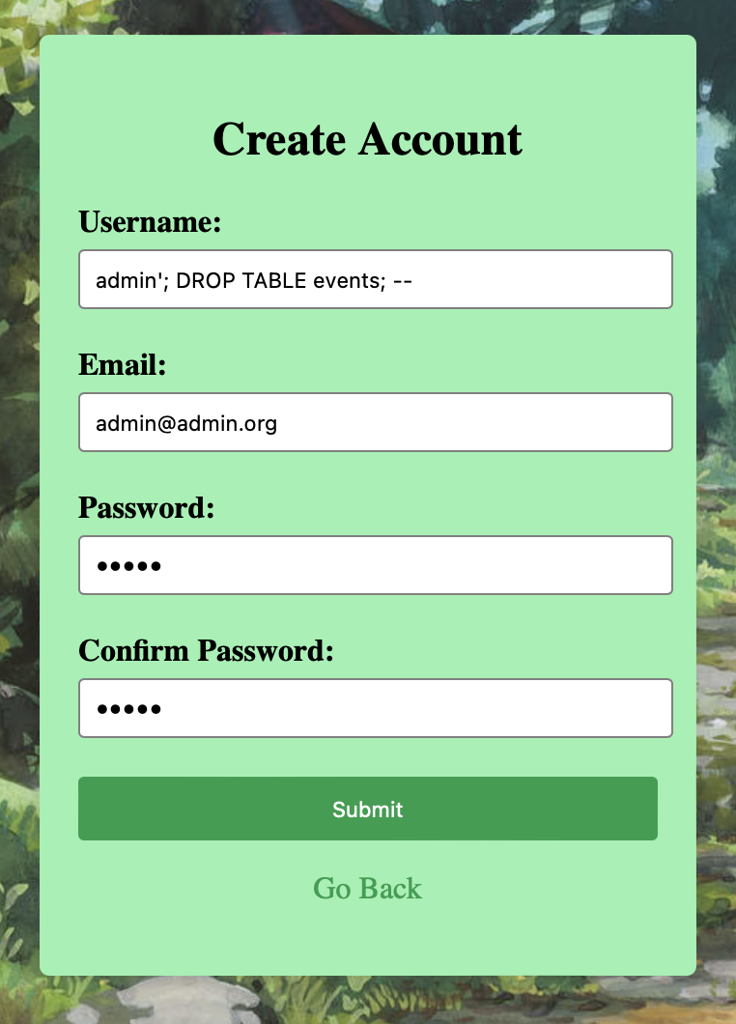
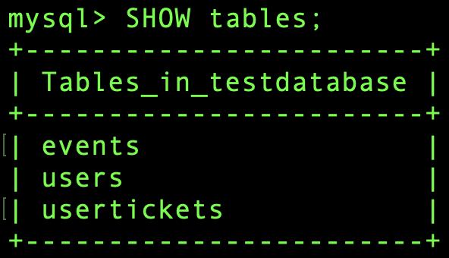
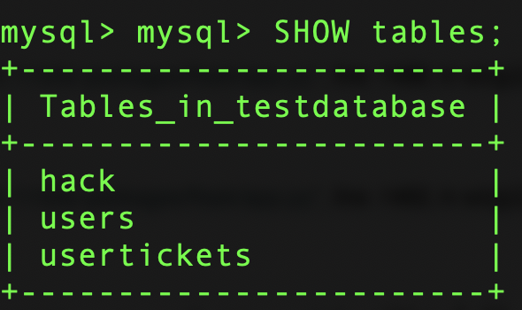
Findings and Results
Database before
Example of SQL injection attacks on unsafe mode.
Database after

Slide 24
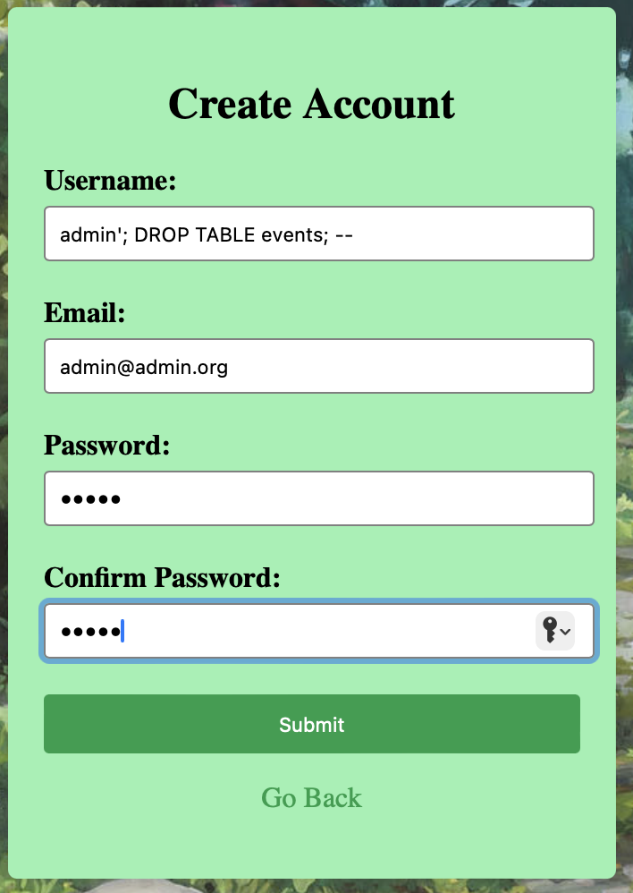
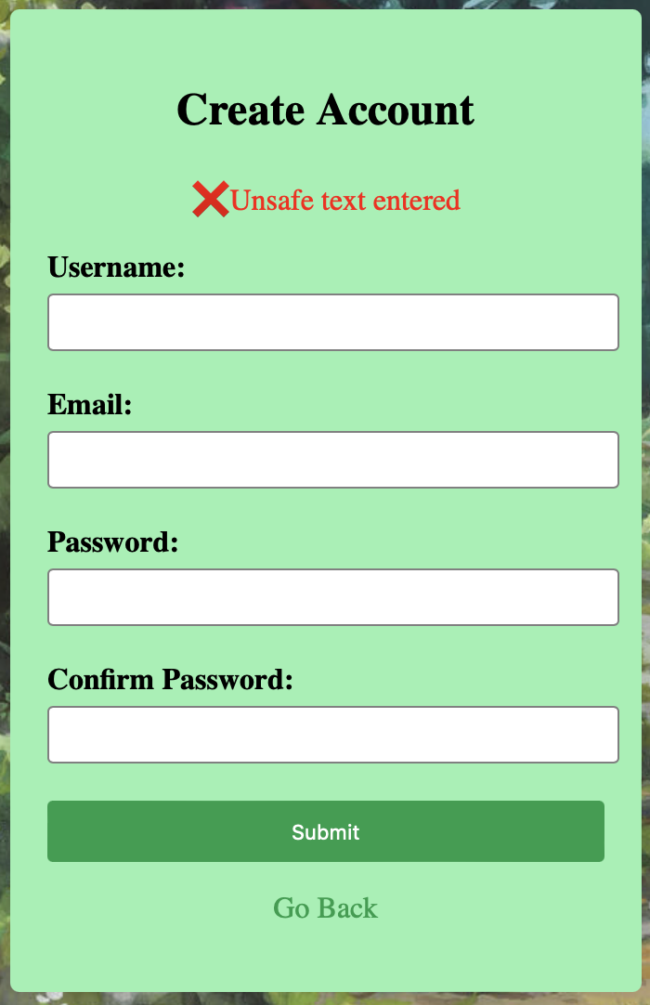
Findings and Results
Safe mode did not allow for SQL injection attacks in the same input fields due to the use of parameterized queries and input sanitation.
Notes:
Emely

Slide 25
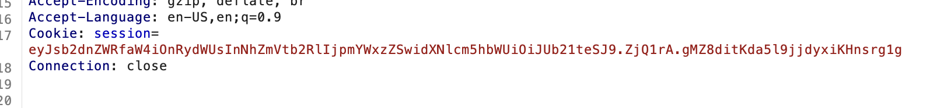
Findings and Results
However, even with all safeguards present, the website was still vulnerable to other points of attack even in safe mode.
Used cURL and Burp Suite to aid in identifying other web vulnerabilities.
Constructed modified HTTP GET requests.
Session Hijacking: cookies are available unencrypted via HTTP request proxy interception.
Notes:
Emely

Slide 26
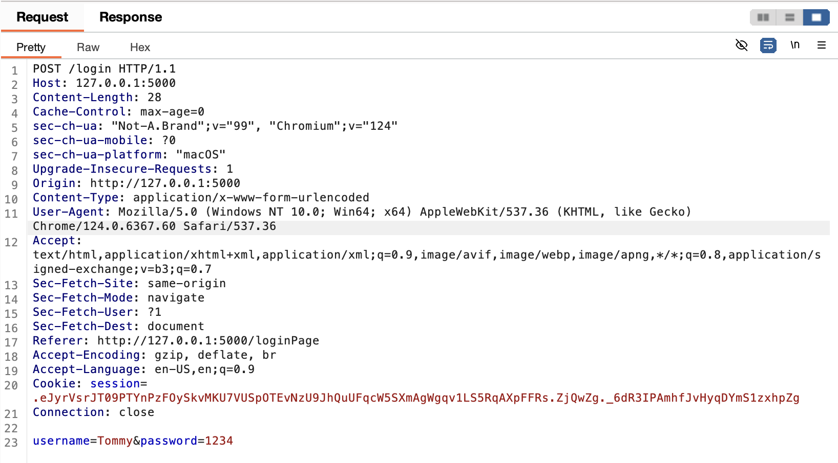
Findings and Results
Plain text input fields may lead to leakage of sensitive information, including credentials.
Notes:
Emely

Slide 27
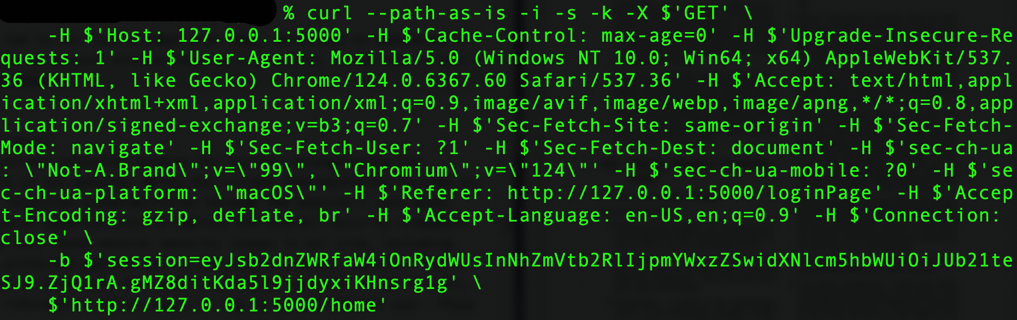
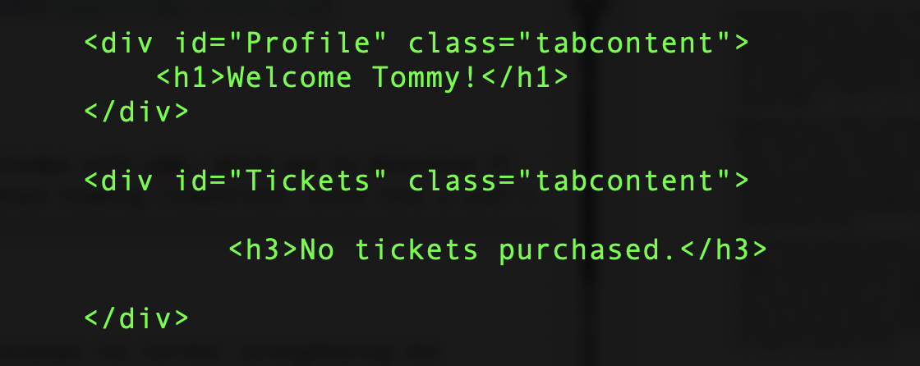
Findings and Results
Access account without credentials by utilizing user’s session cookie.

Slide 28
Future Works
Man in the middle attacks
Packets, POSTs, and requests can be observed
Submission fields are sent in plain text
Users can log in as a different user via cookie information
Our website currently protects against SQL Injection, however, it still has many vulnerabilities:
Notes:
Emely

Slide 29
Future Works
Enhanced Security Measures
Enable HTTPS encryption
Securing User Authentication
Password policies
Multi-factor authentication
Protecting Session Management
Session timeouts
Transport Layer Security
Protects against eavesdropping
Enforcing Secure Cookies
Reduces the risk of XSS attacks
Cross-Site Forgery Protection
Prevents unauthorized actions initiated by forged requests.
Notes:
Emely

Slide 30
Group Members:
Contributions to Final Presentation
Ester Aguilera - slides on Motivation and Search Functionality
Jingru Dou - Contribution slides
Kelsey Knowlson - Problem statement and safe mode slides
Victoria Lien - Findings and results slides
Bryce Palmer - Findings and results slides
Emely Seheon - Purchase Button Functionality and Future Works slides
Lasair Servilla - Methodology introduction, walkthrough, and behind the scenes slides

Slide 31
Questions

